Slide 1
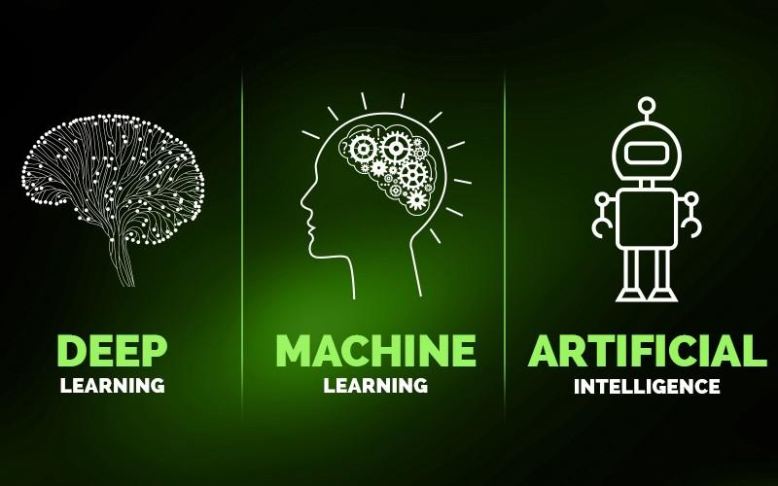
Deep Learning Holiday Image -----------Manipulation----------
By: Noah Walsh, Ben Valois, Rick Djeuhon-Mbankeu, Jake Hamilton, Derek Windahl

Slide 2
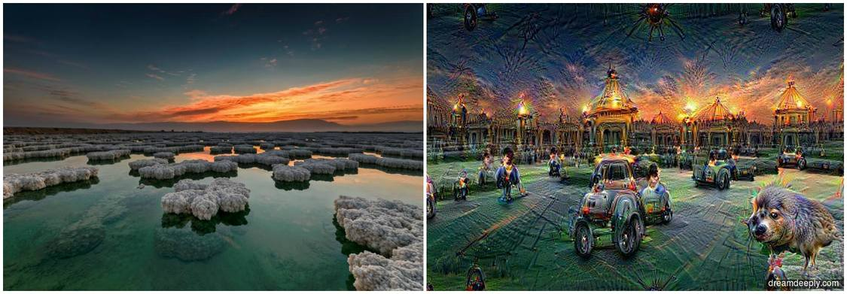
What is Image Manipulation?
Images From: https://www.google.com/url?sa=i&source=images&cd=&cad=rja&uact=8&ved=2ahUKEwj80OGM4ZPfAhWxmuAKHc0NAP4QjRx6BAgBEAU&url=https%3A%2F%2Fwww.fromthegrapevine.com%2Fphotos%2Finnovation%2Flandscapes-transform-strange-scenes-googles-deepdream-tool&psig=AOvVaw3_DPr2XyF2jaXM9GzRWEvx&ust=1544479609339366

Slide 3
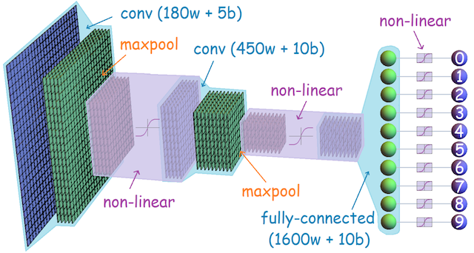
Hidden Layers within Convolutional Neural Networks
Image from: https://leonardoaraujosantos.gitbooks.io/artificial-inteligence/content/Images/ConvnetDiagram.png

Slide 4
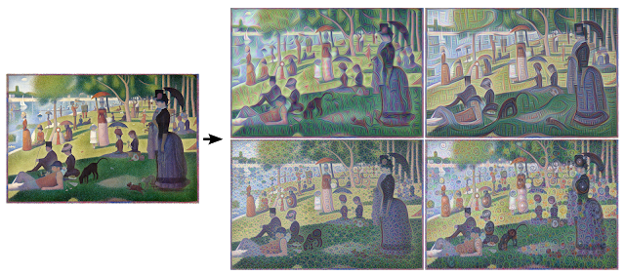
What is Google Deep Dream?
Image from: https://ai.googleblog.com/2015/06/inceptionism-going-deeper-into-neural.html

Slide 5
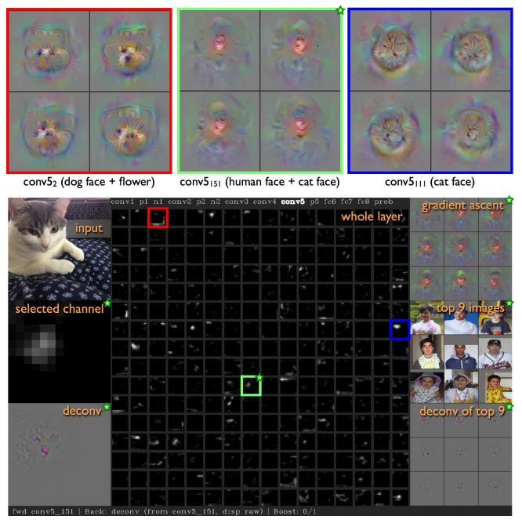
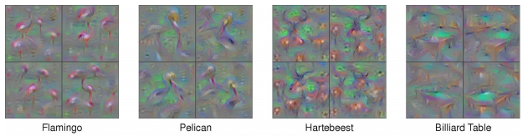
Other Projects: Deep Dream-Based Visualizations
Tools to see what is happening in each layer.
Images from: http://yosinski.com/media/papers/Yosinski__2015__ICML_DL__Understanding_Neural_Networks_Through_Deep_Visualization__.pdf

Slide 6
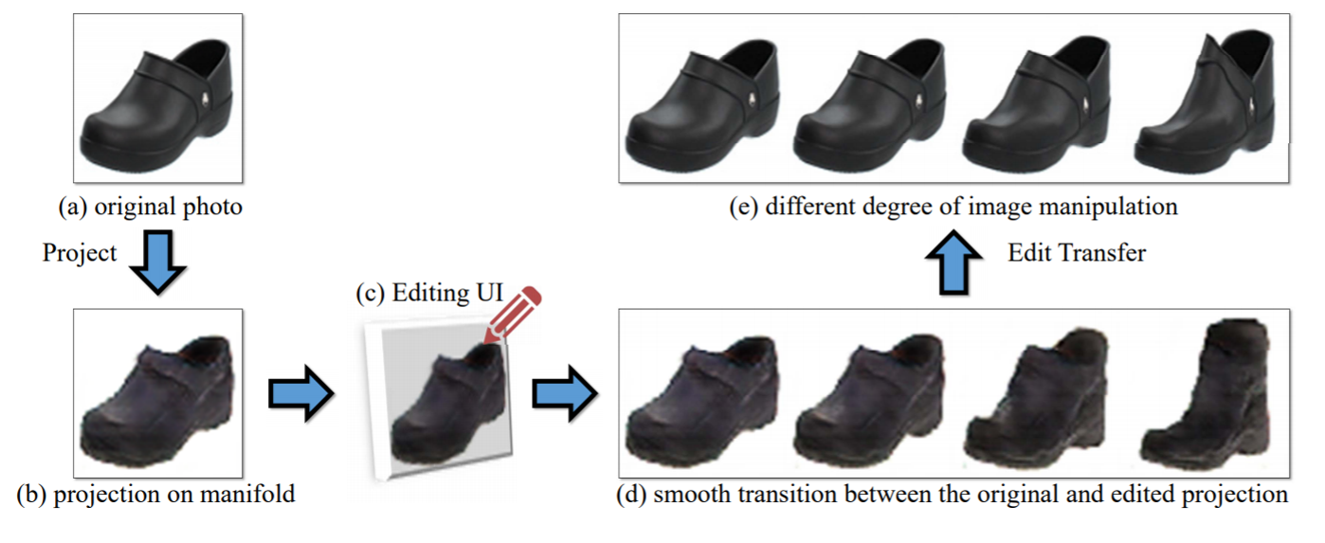
Other Projects: Deep Convolutional Generative Adversarial Networks (DCGANs)
Image from: https://www.philkr.net/papers/2016-10-01-eccv/2016-10-01-eccv.pdf page 2

Slide 7
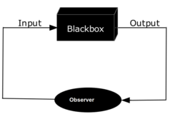
Purpose Of Deep Dream
We don’t fully understand what the computer depicts as a preferred feature for recognizing images.
This is known as the black box of computer learning
DeepDream is an attempt to uncover what occurs in the black box through visualization.

Slide 8
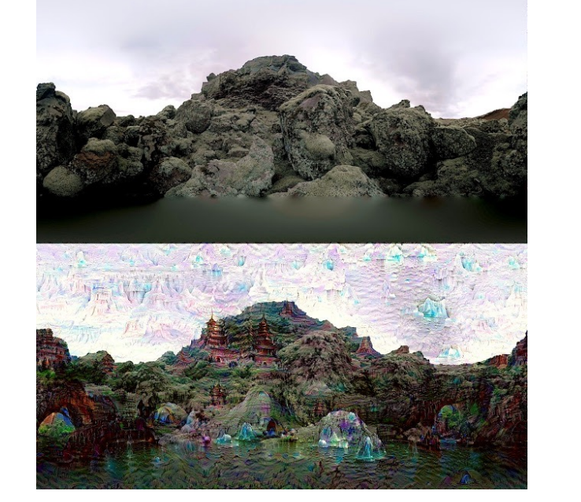
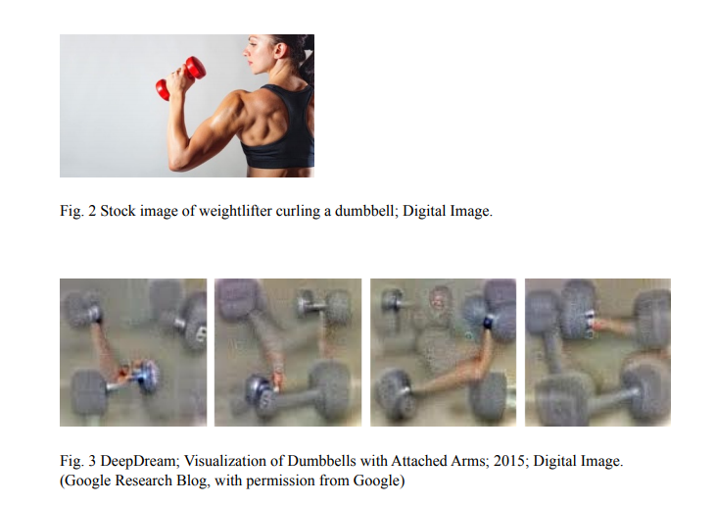
Connections Between Science And Art
Image from: https://arxiv.org/ftp/arxiv/papers/1802/1802.01274.pdf
Image from: https://arxiv.org/ftp/arxiv/papers/1802/1802.01274.pdf
Notes:
Vision technology can help with the understanding of the mechanisms at work in machine-guided image recognition.
Which can lead to the creation of new tools for artists
Initial purpose
The use of deep learning as a tool to better understand image recognition

Slide 9
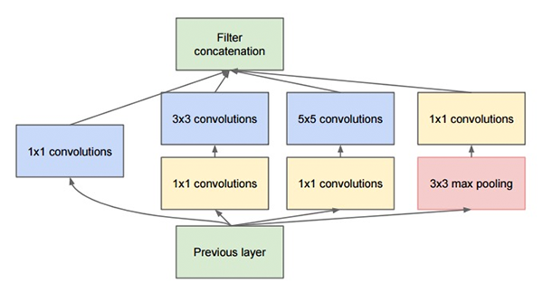
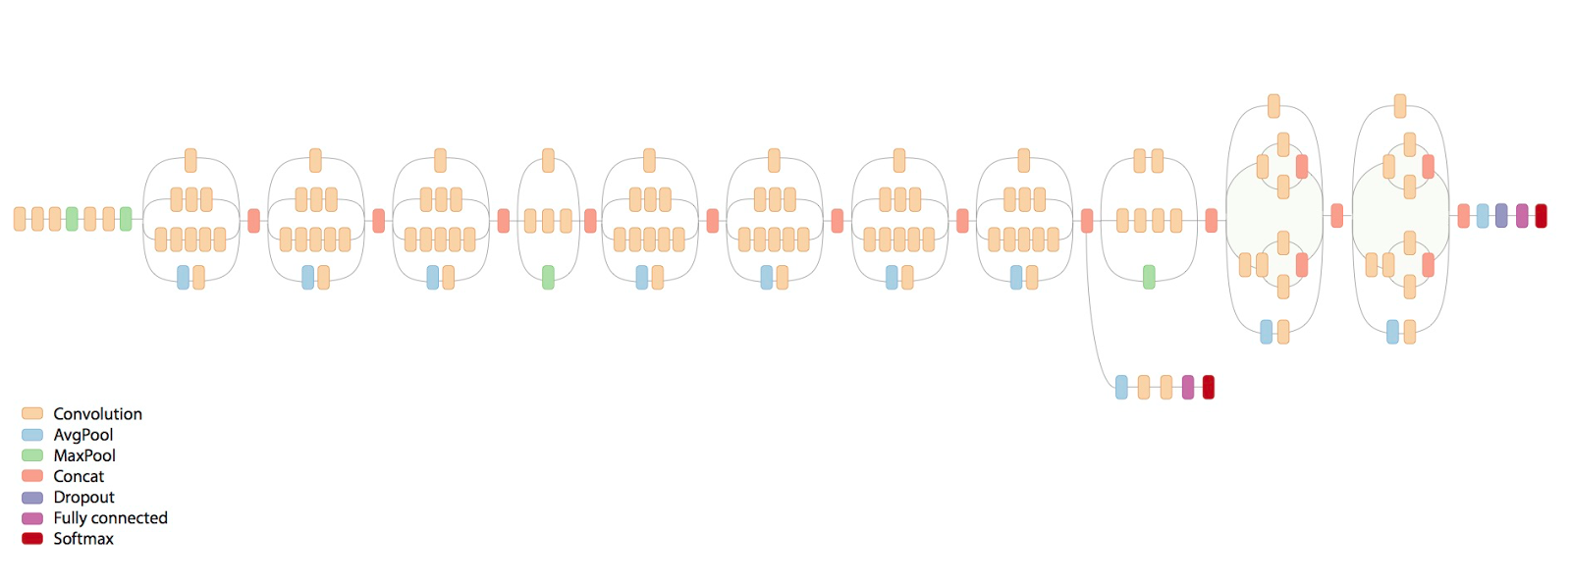
DeepHoliday Architecture: Inception V3
Image from: https://www.pyimagesearch.com/wp-content/uploads/2017/03/imagenet_inception_module.png
Image from: https://hackathonprojects.files.wordpress.com/2016/09/74911-image03.png

Slide 10
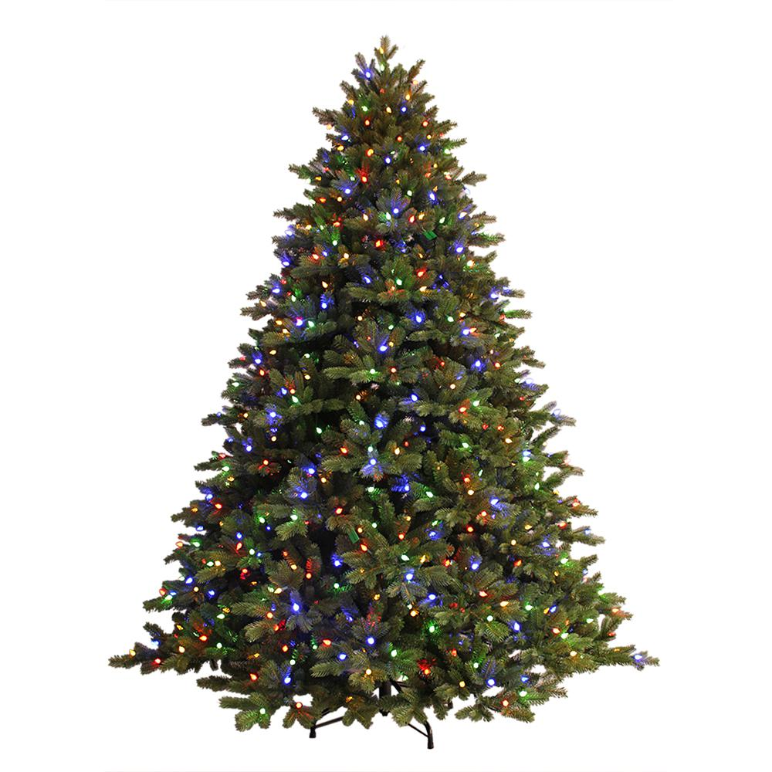
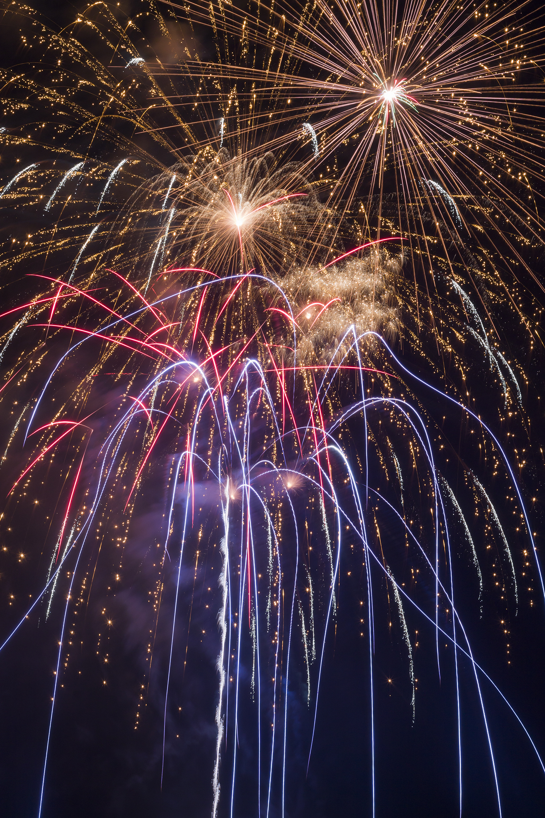
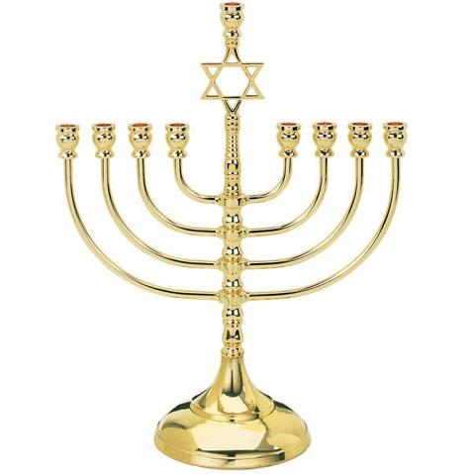

Classification Dataset
Images From:
Left: https://images.homedepot-static.com/productImages/af68091e-a496-426c-858e-20ea60e01f02/svn/ge-pre-lit-christmas-trees-17167hd-64_1000.jpg
Center Left: https://upload.wikimedia.org/wikipedia/commons/3/34/Canada_Day_2016_Fireworks_%2827929885402%29.jpg
Center Right: https://cdn.shopify.com/s/files/1/1985/6561/products/vi1583-CLASSIC-BRASS-PLATED-MENORAH_800x.jpg?v=1516205314
Right: http://presentepravoce.files.wordpress.com/2011/10/christmas_frame1.jpg

Slide 11
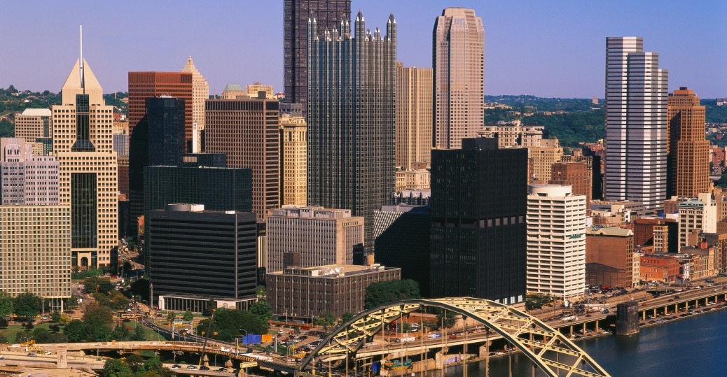
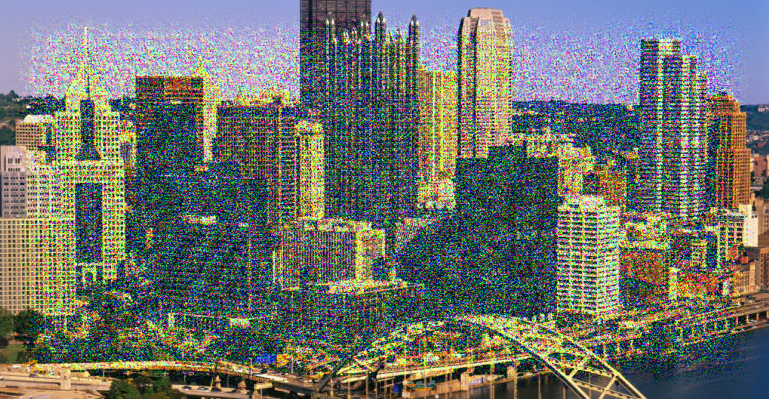
DeepHoliday Image Results
Images From: https://cdn.history.com/sites/2/2013/11/pennsylvania-pittsburg-skyline.jpg

Slide 12
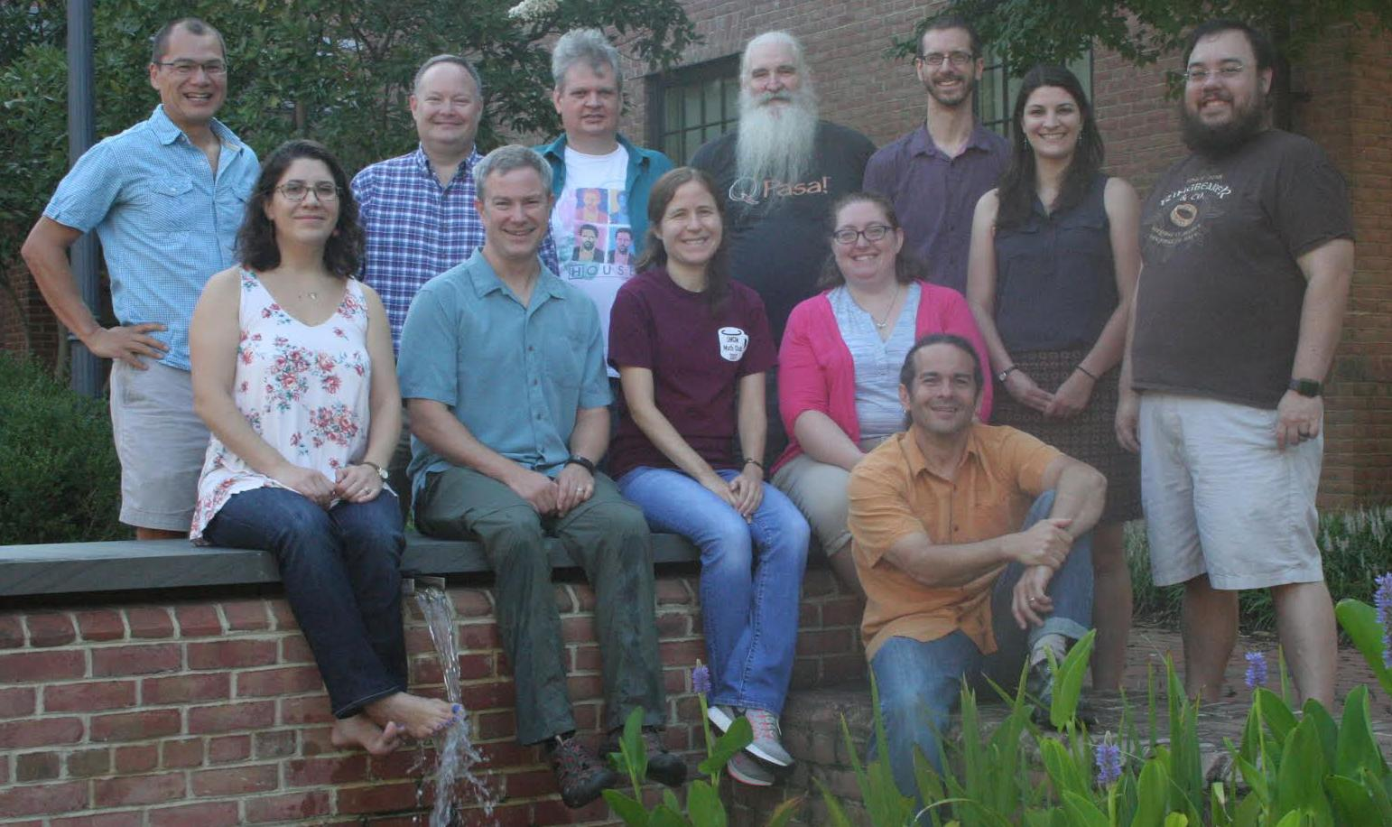
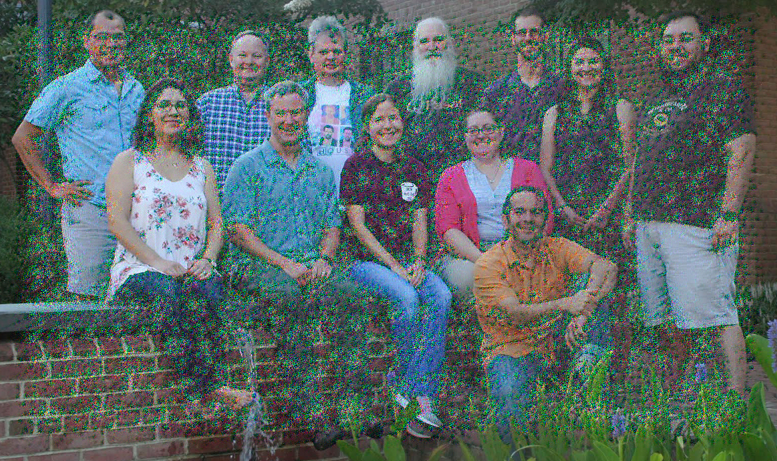
Image from: https://proxy.duckduckgo.com/iu/?u=http%3A%2F%2Fwww.smcm.edu%2Fmathcs%2Fwp-content%2Fuploads%2Fsites%2F23%2F2017%2F09%2FMathandCSfaculty_2017_cropped.jpg&f=1

Slide 13
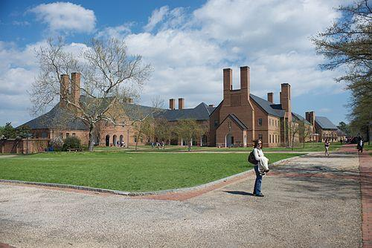
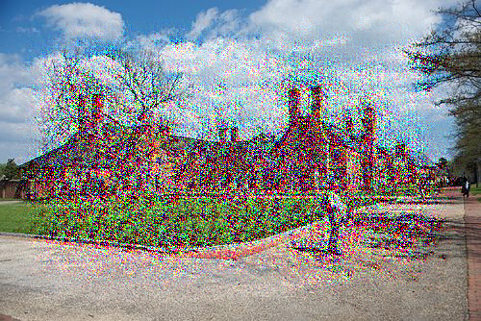
Image from: https://proxy.duckduckgo.com/iu/?u=https%3A%2F%2Fupload.wikimedia.org%2Fwikipedia%2Fcommons%2Fthumb%2F8%2F82%2FSt._Mary%2527s_College_of_Maryland_SMCM.jpg%2F500px-St._Mary%2527s_College_of_Maryland_SMCM.jpg&f=1

Slide 14
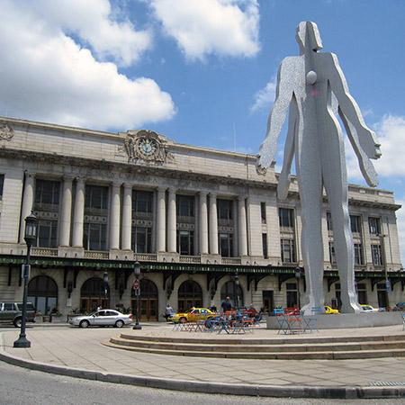
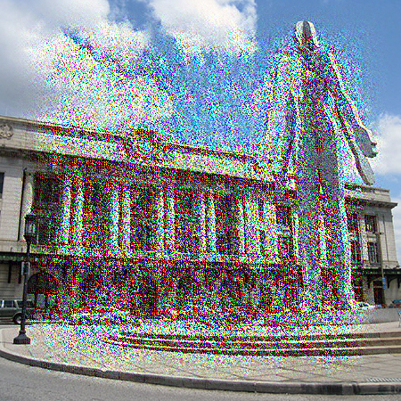
Image from: https://proxy.duckduckgo.com/iu/?u=http%3A%2F%2Fwww.greatamericanstations.com%2Fwp-content%2Fuploads%2F2016%2F10%2FbaltimorepennMD.jpg&f=1

Slide 15
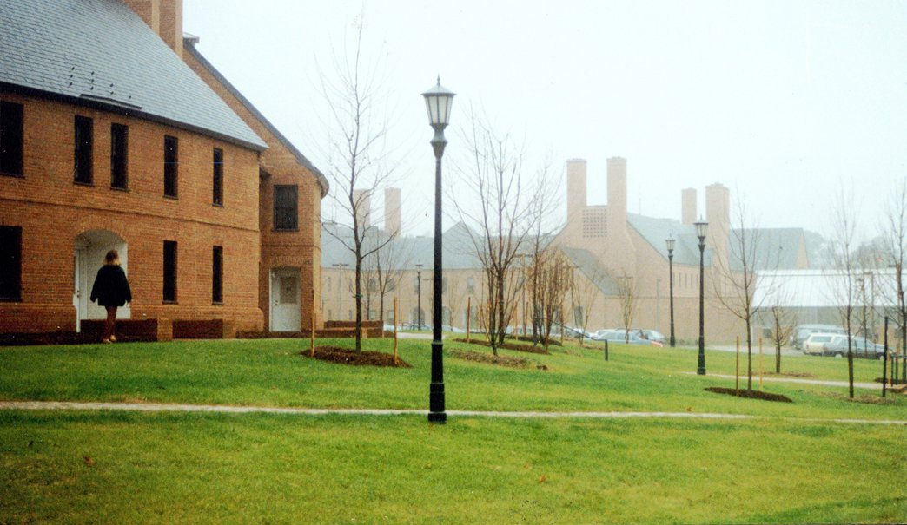
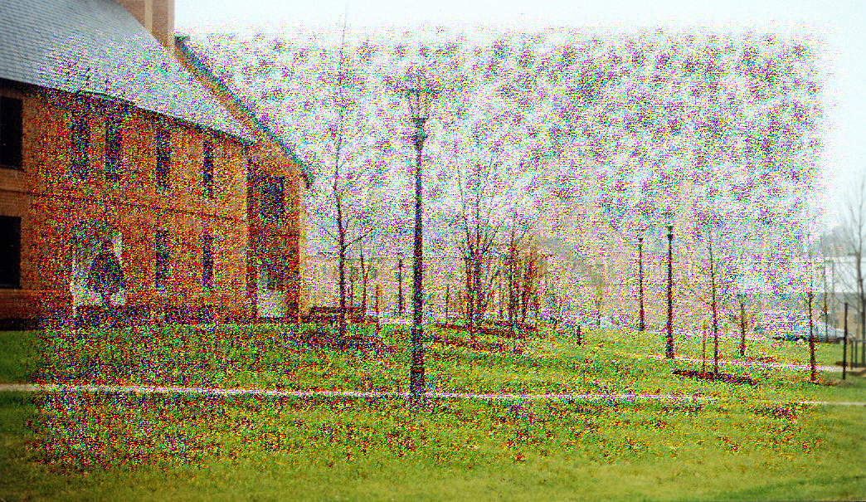
Image from: https://proxy.duckduckgo.com/iu/?u=http%3A%2F%2Fvergason.net%2Fadmin%2Fapp%2Fsite%2Fimg%2Fgallery%2Fprojects%2F31%2F511139141b789_STM_02.jpg&f=1

Slide 16
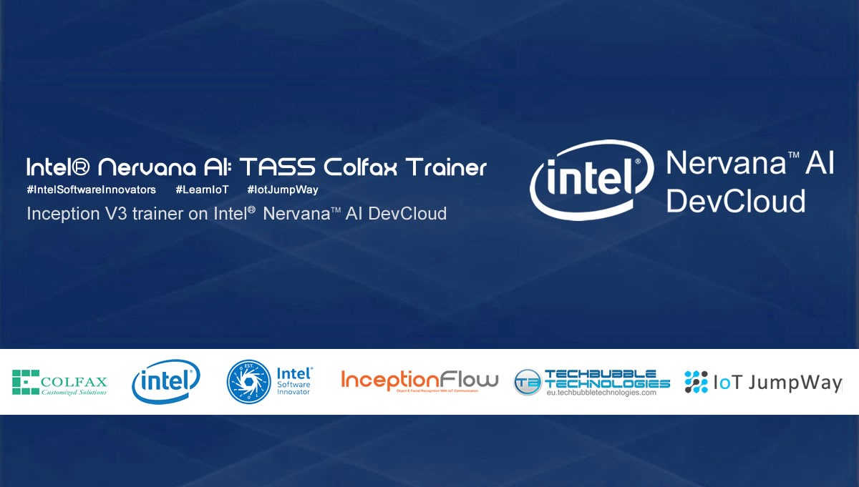
Issues and Concerns
Running on Dev Cloud in other environments
Running in Ipython
Relatively small dataset
Trial and error manipulations
Image From:
https://cdn-images-1.medium.com/max/1200/1*A8o0x9A8sPAn97NsjrAAlQ.jpeg

Slide 17
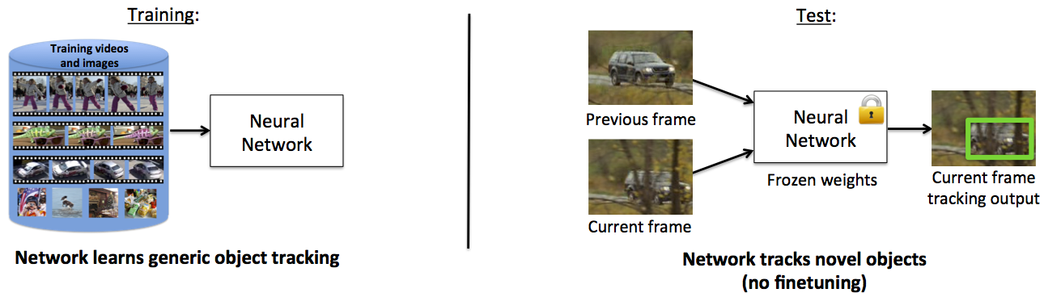

Issues and Concerns
Our change from Object Tracking Through Occlusion
GOTURN: https://github.com/davheld/GOTURN
We tried GOTURN
We tried a combination of YOLO and Keras Object Tracker
We couldn’t get either of them to work so we spent our time theorising ways to get it to track through occlusion once we did
Eventually we had to quit and change topics in order to get some kind of working code
YOLO Image: https://cdn-images-1.medium.com/max/1600/1*QOGcvHbrDZiCqTG6THIQ_w.png
Notes:
Originally we had the topic of Object Tracking Through Occlusion. This was a project that we ended up having a lot of trouble with. Since we knew very little about creating our own object tracker, we had to use the internet to try and find one that would work

Slide 18
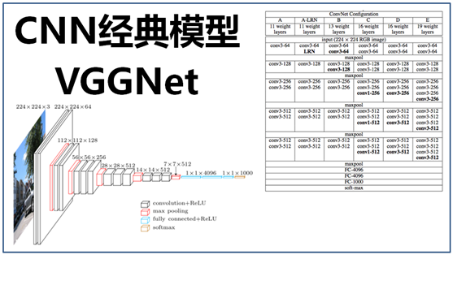
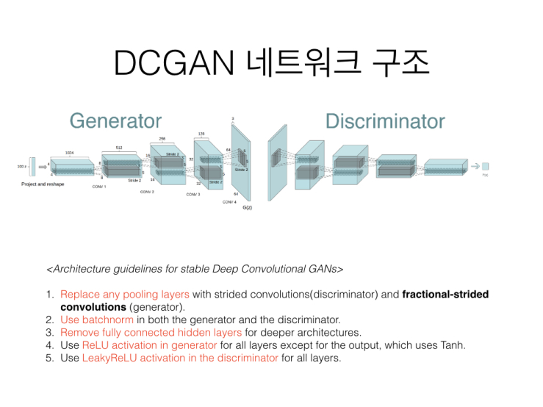
Future goals: Next steps
Increase dataset size
Test on other network architectures
Incorporate DCGANs
Image from: https://www.google.com/url?sa=i&source=images&cd=&cad=rja&uact=8&ved=2ahUKEwjE5ci74ZPfAhVjkeAKHdzgD18QjRx6BAgBEAU&url=https%3A%2F%2Fmy.oschina.net%2Fu%2F876354%2Fblog%2F1634322&psig=AOvVaw2WAASN7271KBXQEpvAFIva&ust=1544479689818694
Image from: https://www.google.com/url?sa=i&source=images&cd=&cad=rja&uact=8&ved=2ahUKEwj7tPqK4pPfAhWDY98KHWr-BlYQjRx6BAgBEAU&url=https%3A%2F%2Fkakalabblog.wordpress.com%2F2017%2F06%2F10%2Fgandcgan-%25EB%25A6%25AC%25EB%25B7%25B0-%25EB%25B0%259C%25ED%2591%259C%2F&psig=AOvVaw035-ofkPOqXuFGS9-6-RXY&ust=1544479782394633

Slide 19
Questions?

